Slide 1
Syntactic Pattern Recognition

Slide 2
Syntactic Pattern Recognition
Statistical pattern recognition attempts to classify patterns based on a set of extracted features and an underlying statistical model for the generation of these patterns. Ideally, this is achieved with a rather straightforward method.
determine the feature vector,
train the system,
classify the patterns
Patterns that include structural or relational information are difficult to represent as feature vectors.
Syntactic pattern recognition uses this structural information for classification and description.

Slide 3
Some simple geometrical patterns
Square
Rectangle
Circle

Slide 4
Primitive patterns or sub-patterns required for classification
a
b
c
d
e
f
g
h

Slide 5
Description of patterns in terms of sub-patterns
Square
a e b f d e c
Rectangle
a e e b f d e e c
Circle
g h

Slide 6
Problems in classical approach of PR in handling patterns having typical geometrical shapes

Slide 7
Syntactic Pattern Recognition
Grammars can be used to create a definition of the structure of each pattern class.
Then, recognition and classiﬁcation are done using either:
Parsing using formal grammars (called Syntactic Pattern Recognition)
or
Relational graph matching( called Hierarchical approach )

Slide 8
Classification
Classification can be done based on a measure of structural similarity in patterns.
Each pattern class can be represented by a structural representation or description.

Slide 9
Description
A description of the pattern structure is useful for recognizing entities when a simple classification isn’t possible.
Can also describe aspects that cause a pattern not to be assigned to a particular class.
In complex cases, recognition can only be achieved through a description for each pattern rather than through classification.

Slide 10
Definitions
The simplest sub-patterns are called pattern primitives, and should be much easier to recognize than the overall patterns.
The language used to describe the structure of the patterns in terms of sets of pattern primitives is called the pattern description language.
The pattern description language will have a grammar that specifies how primitives can be composed into patterns

Slide 11
Syntax Analysis
When a primitive within the pattern is identified, syntax analysis (parsing) is performed on the sentence describing the pattern to determine if it is correct with respect to the grammar.
Syntax analysis also gives a structural description of the sentence associated with the pattern.
One advantage of this approach is that a grammar (rewriting) rule can be applied many times.

Slide 12
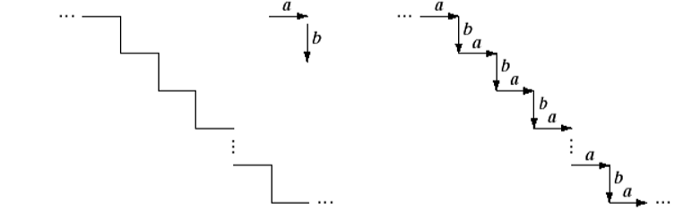
Pattern Description Using Grammar
Fig 1: (a) Staircase structure (b) structure encoded in terms of primitive a and b to yield the description …ababab…
a b

Slide 13
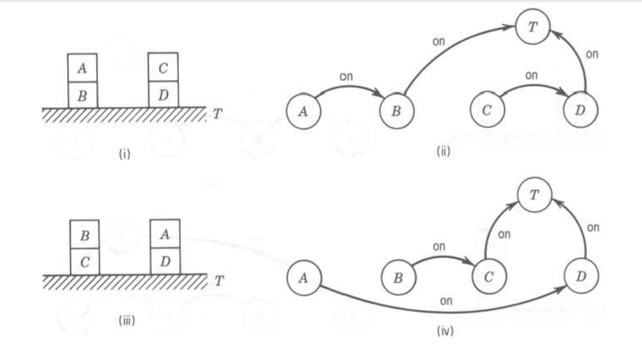
Pattern Description Using Grammar
Fig 2: A grammar describing four blocks arranged in 2-block stacks. (i) An example. (ii) Graphical description corresponding to (i). (iii) Another example. (iv) Graphical description corresponding to (iii).

Slide 14
Pattern Description Using Grammar
A grammar describing four blocks arranged in 2-block stacks:
V_{T} = { table , block , + , ↑ } (terminal symbols)
V_{N} = { DESK,LEFT STACK,RIGHT STACK}
(non-terminal symbols)
S = DESK ∈ V_{N} (root symbol)
P = {DESK → LEFT STACK + RIGHT STACK
DESK → RIGHT STACK + LEFT STACK
LEFT STACK → block ↑ block ↑ table
RIGHT STACK → block ↑ block ↑ table}
(production rules)

Slide 15
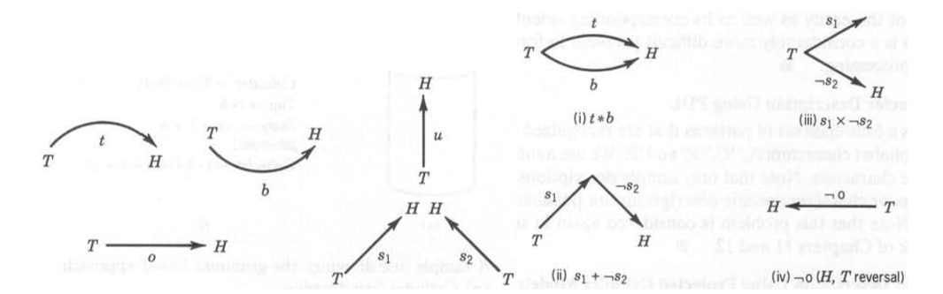
Pattern Description Using Grammar
Fig 3: A 2-D line drawing picture description grammar
A set of terminal symbols { t, b, u, o, s ,*,-,+} where
+ represents head to tail concatenation,
* represents head-head and tail-tail attachment,
– represents the head-tail reversal. ( x should be * in (iii) )

Slide 16
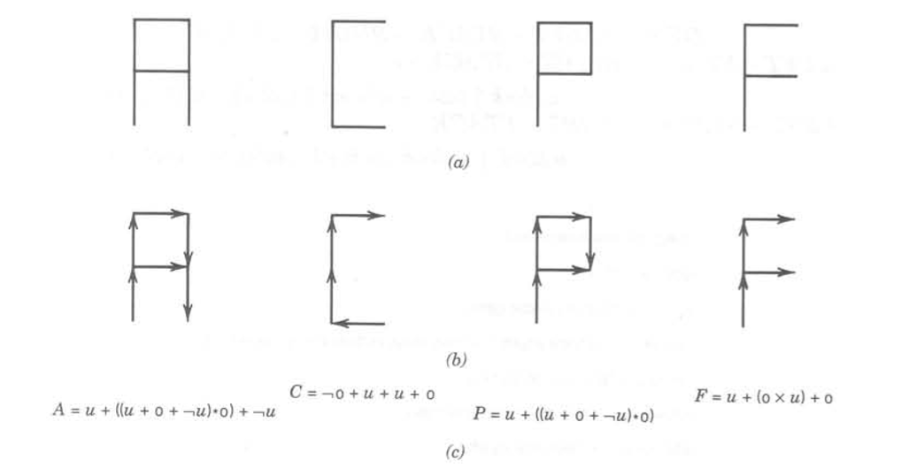
Pattern Description Using Grammar
.
Fig 4: Representation of four characters using the line drawing picture description grammar
(a) Pattern data. (b) Primitive representation and interconnection. (c) Corresponding descriptions

Slide 17
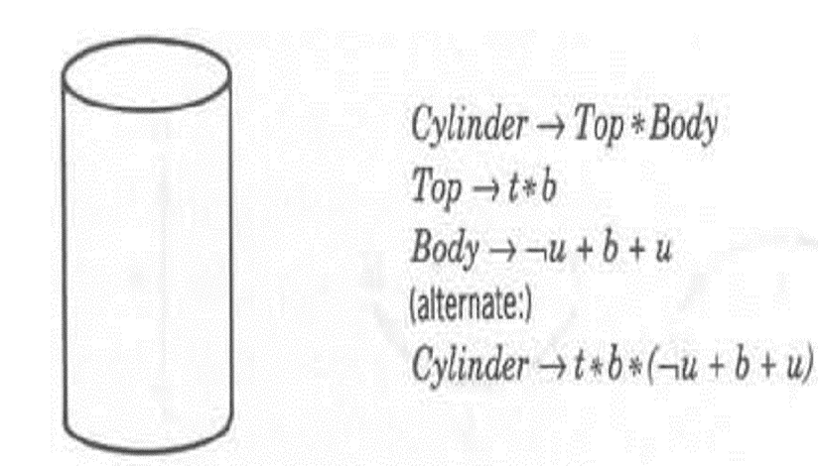
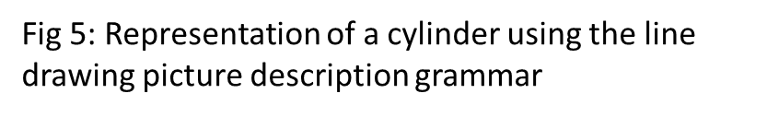
Pattern Description Using Grammar

Slide 18
When to Use It
Picture recognition and scene analysis are problems in which there are a large number of features and the patterns are complex.
For example, recognizing areas such as highways, rivers, and bridges in satellite pictures.
In this case, a complex pattern can be described in terms of a hierarchical composition of simpler sub patterns.

Slide 19
Syntactic System
.
Pattern Representation
preprocessing
Segmentation or Decomposition
Primitive Recognition
Syntax (or structural) analysis
Classification
Input pattern
And Description
recognition
- - - - - - - - - - - - - - - - - - - - - - - - -- -
- - - - - - -- -
- - - - - - - - - - - - - - - - - - - - -- -
- - - - - - - - - - - - - - - --
Analysis
Primitive (and relation) selection
Grammatical (or structural) inference
sample
pattern
Fig 6 :Block Diagram of a syntactic pattern recognition system

Slide 20
Syntactic System
Fig 7: Using Syntactic Patter Recognition for Classification
Library of classes categorized by structures
Class1 Structure
Class2 Structure
Class C Structure
….
Structural Analysis
Structural Matcher
Relevant Matches
Input

Slide 21
Syntactic System
Consists of two main parts:
Analysis -primitive selection and grammatical or structural inference
Recognition -preprocessing, segmentation or decomposition, primitive and relation recognition, and syntax analysis.
Preprocessing includes the tasks of pattern encoding and approximation, filtering, restoration, and enhancement.
After preprocessing, the pattern is segmented into sub-patterns and primitives using predefined operations.
Sub-patterns are identified with a given set of primitives, so each pattern is represented by a set of primitives with the specified syntactic operations.

Slide 22
Syntax Parsing
For example, using the concatenation operation, each pattern is recognized by a string of concatenated primitives.
At this point, the parser will determine if the pattern is syntactically correct.
It belongs to the class of patterns described by the grammar if it is correct.
During parsing/syntax analysis, a description is produced in terms of a parse tree, assuming the pattern is syntactically correct.
If it isn’t correct, it will either be rejected or analyzed based on a different grammar, which could represent other possible pattern classes.

Slide 23
Matching
The simplest form of recognition is template matching, in which a string of primitives representing an input pattern is compared to strings of primitives representing reference patterns.
The input pattern is classified in the same class as the prototype that is the best match, which is determined by a similarity criterion.
Matching vs. Complete Parsing
In this case, the structural description is ignored.
The opposite approach is a complete parsing that uses the entire structural description.
There are many intermediate approaches; for example, a series of tests designed to test the occurrence of certain primitives, sub-patterns, or combinations of these. The result of these tests will determine a classification

Slide 24
Parsing is required if the problem necessitates using a complete pattern description for recognition.
Efficiency of the recognition process is improved by simpler approaches that do not require a complete parsing.
Basically, parsing can be expensive, so don’t use it unnecessarily.
Inferring Grammars
Grammatical inference machine similar to “learning” in the discriminant approach; it infers a grammar from a set of training patterns.
The inferred grammar can then be used for pattern description and syntax analysis.

Slide 25
Hierarchical Approach
The hierarchical approach comes from the similarity that can be seen between the structure of patterns and the syntax or grammar of languages.
Basic idea: use graphs to represent structural relationships
Primitives: nodes/vertices of a graph
Relationships: arcs/edges of a graph
Essential component: graph matching
Following this analogy, patterns can be built up from sub-patterns in a number of ways, similarly to how one builds words by concatenating characters, and builds a phrase or sentence by concatenating words.

Slide 26
Deﬁnitions
Homomorphism:
A function that relabels one graph into another.
Merging nodes is allowed so long as it preserves the edge relationships.
Isomorphism:
A homomorphism that is 1-to-1 and onto.
Merging nodes not allowed—exact match with nothing changed but labels.

Slide 27
Quick Rejection Criteria
For a match to exist, several things must hold:
same number of vertices
same number of nodes
in-degree of vertices must match
out-degree of vertices must match
cycles and lengths must match
Failure of any of these to match means you can reject the match, but determine the isomorphism requires that you actually ﬁnd the relabeling

Slide 28
Finding Isomorphisms
Use an adjacency matrix representation of the graph
Reorder the rows and corresponding columns
Compare all possible reorderings
Comparison: O(n²)
Possible Permutations: O(n!)
Only really feasible for small n.

Slide 29
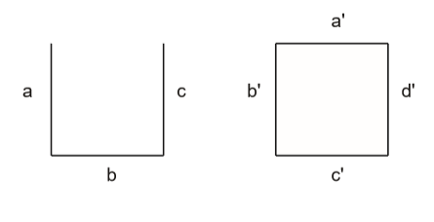
Subisomorphisms
Harder problem: is one pattern part of another one?
Equivalent to ﬁnding subgraph that is isomorphic to another: subisomorphism.
Finding subisomorphisms not only requires determining isomorphism between graph and subgraph, but also considering all possible subgraphs.

Slide 30
Graph Similarity
What if we want to ﬁnd not only identical matches but similar patterns?
What does it mean for graphs to be similar?
One way is to count modiﬁcations required to make one match the other
inserting an edge
deleting an edge
inserting a node
deleting a node
splitting a node
merging two nodes

Slide 31
Match Graphs
I Create a new graph where
each node is a pairing between a node from one attributed graph and compatible node from the other, and
each edge represents consistency (mutual compatibility) between two pairing
A subisomorphism is indicated by a completely-connected subgraph (clique) of the match graph.
The best match is the largest clique.

Slide 32

Attributed Graphs
Idea: can relabel graph nodes, but must match apples to apples and oranges to oranges.
An attributed graph has attributes attached to each vertex.
Matching attributed graphs must not only produce a (sub)isomorphism but must also match attributes

